Slide 1
Mass
Mass is a measure of the amount of matter.
As gravity varies between locations, the weight of an object varies depending on where it is measured – but mass doesn’t change.
The SI unit of mass is kilogram (kg),
in chemistry the smaller gram (g) is often used:
1 kg = 1000 g = 1×10³ g
Atomic mass unit (amu) used to express the masses of atoms and molecules.
1 amu = 1.6605×10⁻²⁴ g

Slide 2

Temperature
Two temperature scales in chemistry:
Celsius scale (ºC)
  Freezing point (pure water): 0 ºC
  Boiling point (pure water): 100 ºC
Kelvin scale (K)
  The “absolute” scale
  Lowest possible temperature: 0 K (absolute zero)
K = ºC + 273.15

Slide 3


Temperature
The Fahrenheit scale is common in the United States.
  Freezing point (pure water): 32 ºF
  Boiling point (pure water): 212 ºF
There are 180 degrees between freezing and boiling in Fahrenheit (212 - 32) but only 100 degrees in Celsius (100 – 0).
  The degree of Fahrenheit scale is only 5/9 of a degree of Celsius scale.
Temp in ºF = ( ×temp ºC ) + 32 ºF

Slide 4


Example 1.2
A body temperature above 39 ºC constitutes high fever. Convert to the Fahrenheit scale.
Strategy We are given a temperature and asked to convert it to degrees Fahrenheit. Use equation:
Temp in ºF = ( × temp in ºC ) + 32 ºF
Solution Temp in ºF = ( × 39 ºC ) + 32 ºF
Temp in ºF = 102 ºF
Check your work
As the normal body temperature on the Fahrenheit scale is about 98.6 ºF, 102 ºF seems reasonable.

Slide 5
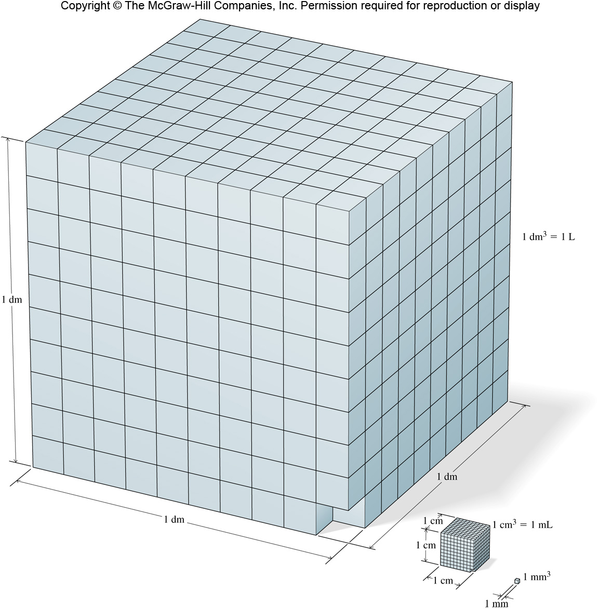
Derived Units: Volume and Density
Many quantities (e.g., volume) require units not included in the base SI units.
The derived SI unit for volume is the meter cubed (m³).
A more practical unit for volume is the liter (L).
1 dm³ = 1 L
1 cm³ = 1 mL

Slide 6

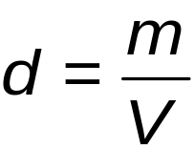
Derived Units: Volume and Density
The density of a substance is the ratio of mass to volume.
  d = density
  m = mass
  V = volume
SI-derived unit: kilogram per cubic meter (kg/m³)
Other common units: g/cm³ (solids)
g/mL (liquids)
g/L (gases)

Slide 7
Example 1.3
Ice cubes float in a glass of water because here solid is less dense than liquid. (a) Find the ice density if, at 0°C, a cube with 2.0 cm sides has 7.36 g mass (b) determine the volume of 23 g of ice at 0°C.
Strategy (a) Determine density by dividing mass by volume
(b) Use density to determine the volume of given mass
Solution (a) A cube has equal sides, so the volume is (2.0 cm)³ = 8.0 cm³
d =
(b) Rearrange d = m/V to solve for volume: V = m/d
V =
7.36 g
8.0 cm³
= 0.92 g/cm³
23 g
0.92 g/cm³
= 25 cm³
Check your work For a sample with density under 1 g/cm³, the number of cubic centimeters exceeds that grams. Here, 25 cm³ > 23 g.

Slide 8
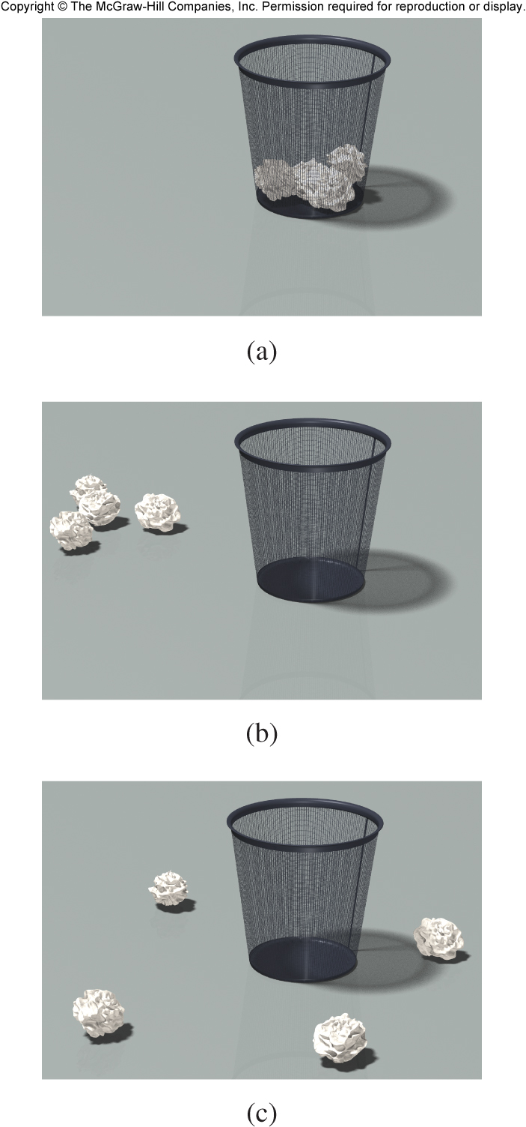
Accuracy and Precision
Accuracy tells how close a measurement is to the true value.
Precision tells how close a series of replicate measurements are to each other.
Precision is same as reproducibility
Good accuracy and good precision
Poor accuracy but good precision
Poor accuracy and poor precision

Slide 9
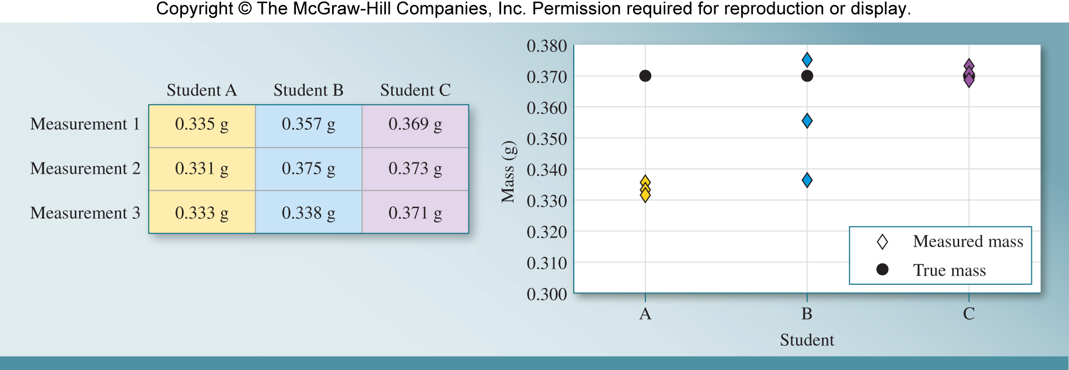
Accuracy and Precision
Three students were measuring the mass of a tablet.
The true mass is 0.370 g.
A: Results are precise but not accurate
B: Results are neither precise nor accurate
C: Results are both precise and accurate

Slide 10

Measurement Uncertainty
1.5
Two types of numbers in chemistry:
1) Exact:
  have defined values
    1 kg = 1000 g
    1 dozen = 12 objects
  or determined by counting
    28 students in a class
2) Inexact:
  measured by any method besides counting
    length, mass, volume, time, speed, etc.

Slide 11
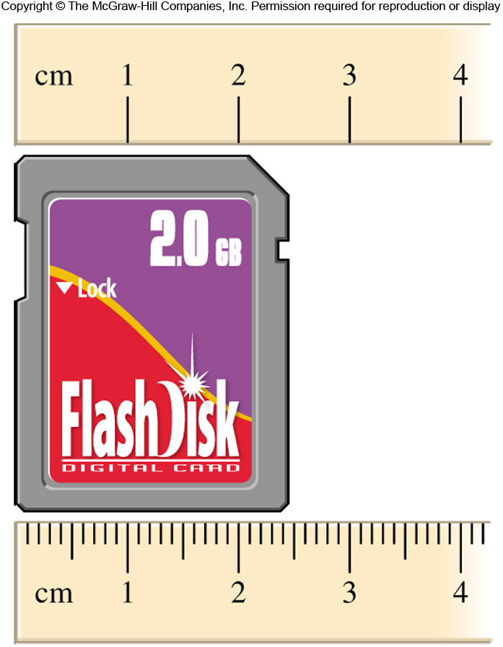
Measurement Uncertainty
Inexact numbers must be reported with indication of uncertainty.
Significant figures are the meaningful digits in a reported number.
The last digit in a measured number is the uncertain digit.
Using the top ruler to measure the memory card, we can estimate 2.5 cm. We are certain about the 2,
but not about the 5.
The uncertainty generally considered to be + 1 in the last digit.
2.5 + 0.1 cm

Slide 12
Measurement Uncertainty
Using the bottom ruler to measure the same card, we record 2.45 cm.
Again, we estimate one more digit than we are certain of.
2.45 + 0.01 cm

Slide 13
Significant Figures
Number of significant figures determined
using the following guidelines:
1) Any non-zero digit is significant.
2) Zeros between non-zero digits are significant.
3) Zeros to the left of first non-zero digit are NOT significant.
112.1
4 sig. figs
305
3 sig. figs
50.08
4 sig. figs
0.0023
2 sig. figs
0.000001
1 sig. fig.

Slide 14
Significant Figures
Zeros to the right of the last nonzero digit are significant
if a decimal is present.
5) Zeros to the right of last nonzero digit in a number with no decimal point may or may not be significant.
1.200
4 sig. figs.
100
1, 2, or 3 – ambiguous

Slide 15
Example 1.4
Determine the number of significant figures in the measurements: (a) 443 cm, (b) 15.03 g, (c) 0.0356 kg, (d) 3.000×10⁻⁷ L, (e) 50 mL, (f) 0.9550 m.
Strategy Zeros are significant between non-zero digits or after a non-zero digit with a decimal. Zeros to the right of a nonzero digit without a decimal may or may not be significant.
Solution (a) 443 cm (b) 15.03 g
(c) 0.0356 kg (d) 3.000 x 10⁻⁷ L
(e) 50 mL (f) 0.9550 m
3 S.F.
4 S.F.
3 S.F.
4 S.F.
1 or 2, ambiguous
4 S.F.
Check your work
Be sure to identify zeros correctly as significant or not. They are significant in (b) and (d) but insignificant in (c); impossible to tell in (e); (f) contains one significant and one insignificant zero.

